Slide 1
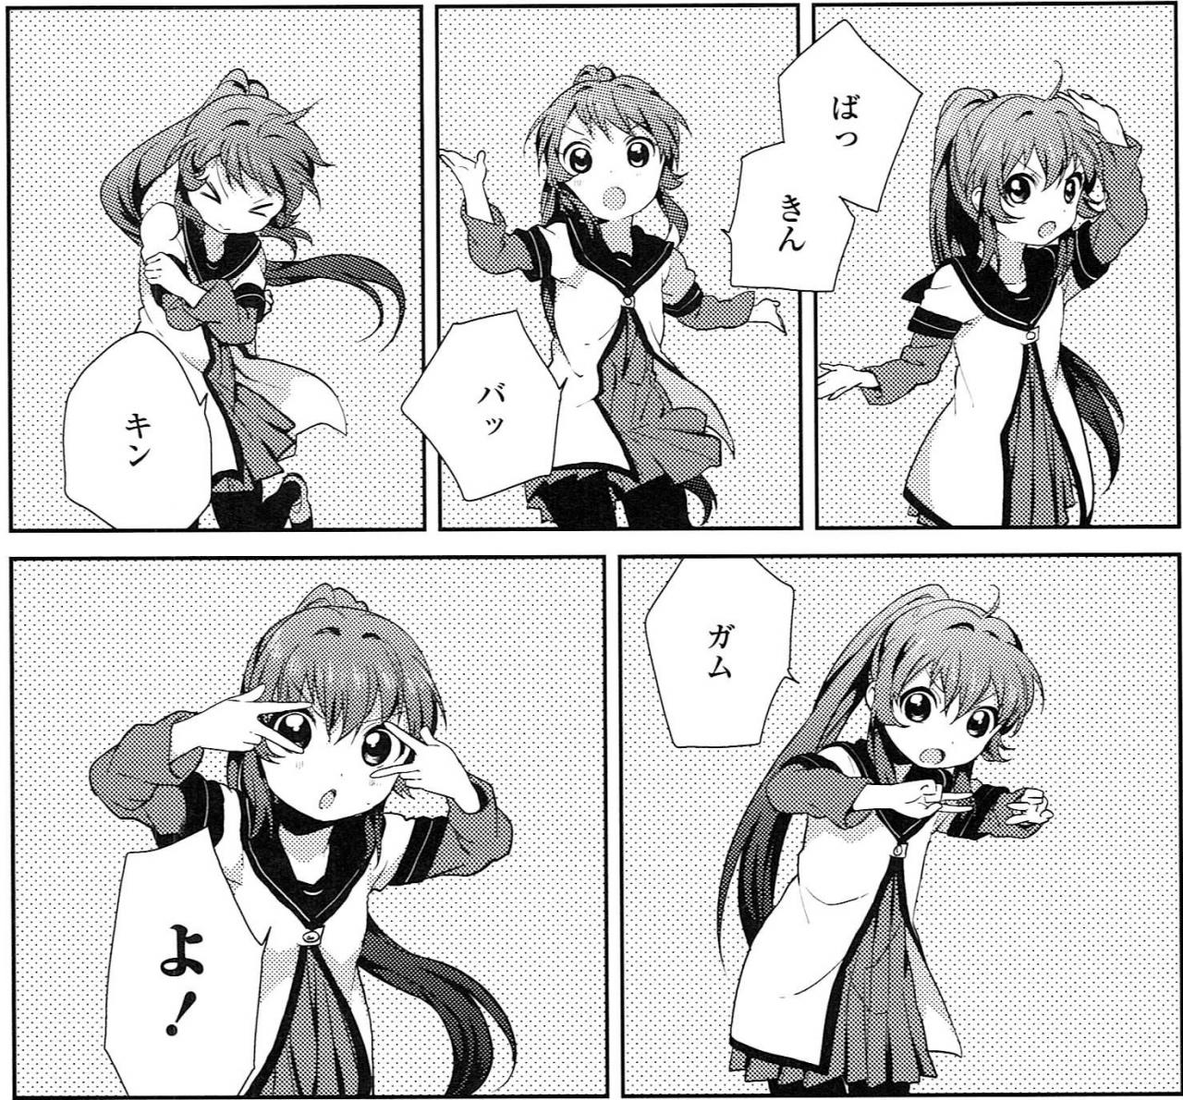

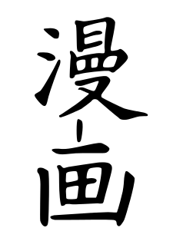
MANGA
Presented by Leo and William!
Not drawn by neither Leo or William though！

Slide 2
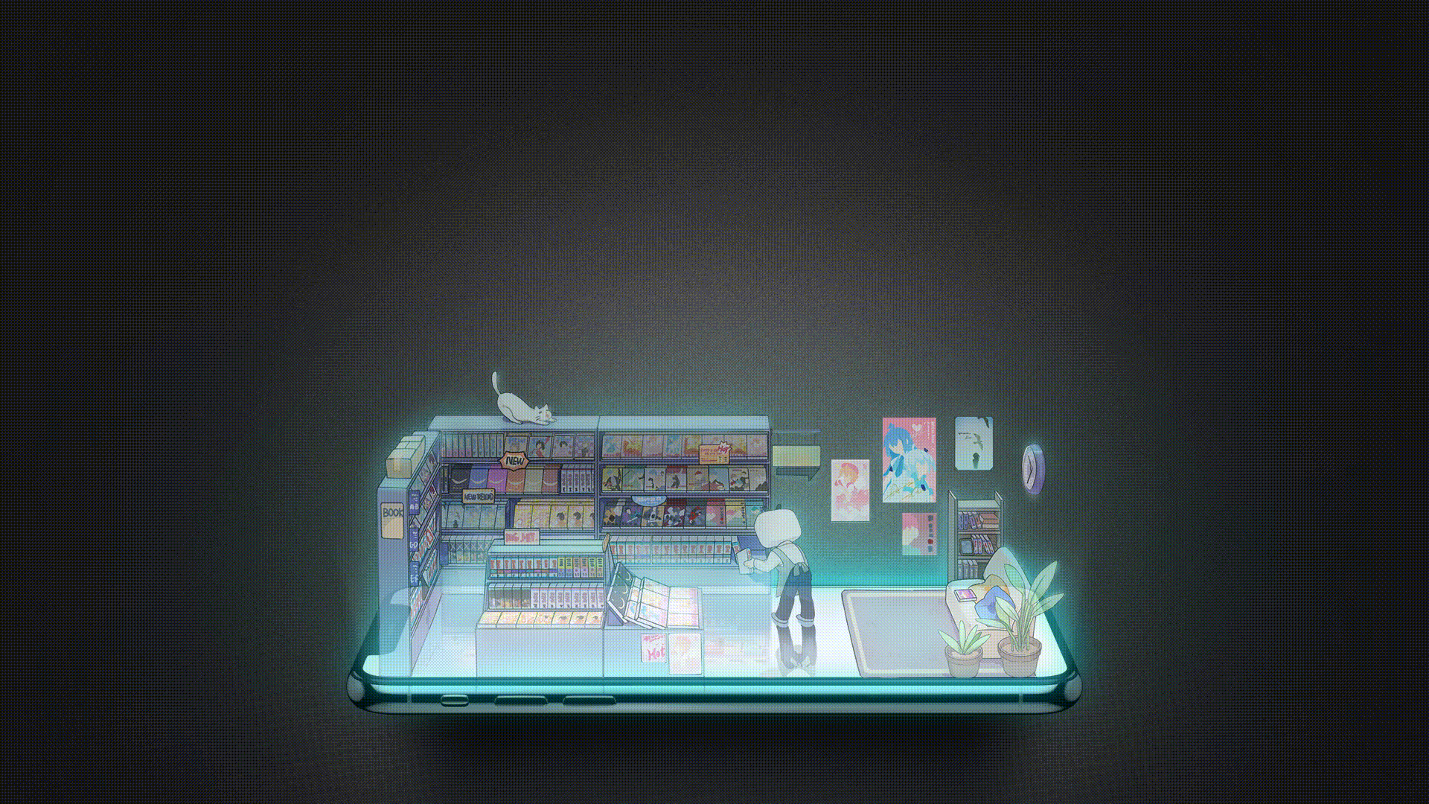
Manga
First type of comic books
Very popular in Japan and Asia
Official manga and fan made manga(doujinshi)

Slide 3


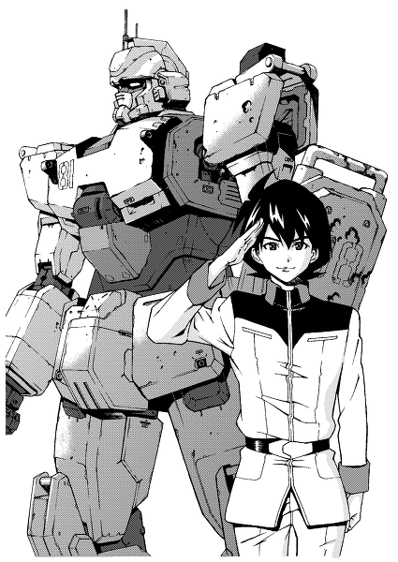
Plot
Tells a story
Normal Genres
Romance
Sci-fi
Comedy
Drama
Others
Mahou shoujo
Mecha
Slice-of-life
Healing

Slide 4
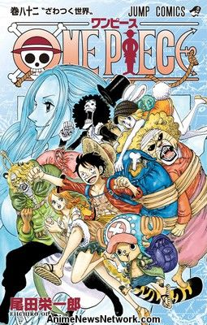
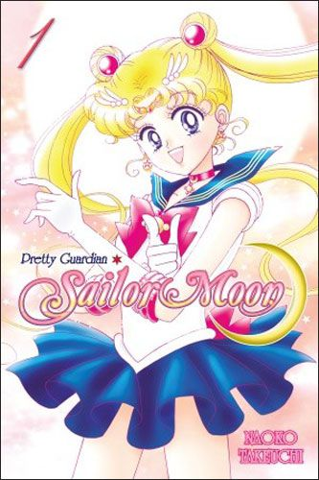

Audience
Any one that can read
Shonen（少年）for boys
Shoujo（少女） for girls
Seinen （青年）for adults

Slide 5
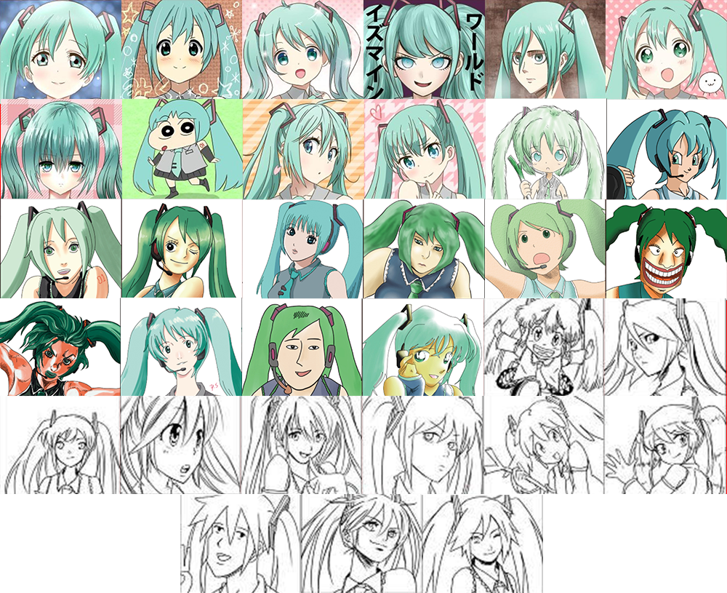
Art style
Used with a meaning
Associated with mood / atmosphere
Some times used for plot twist

Slide 6
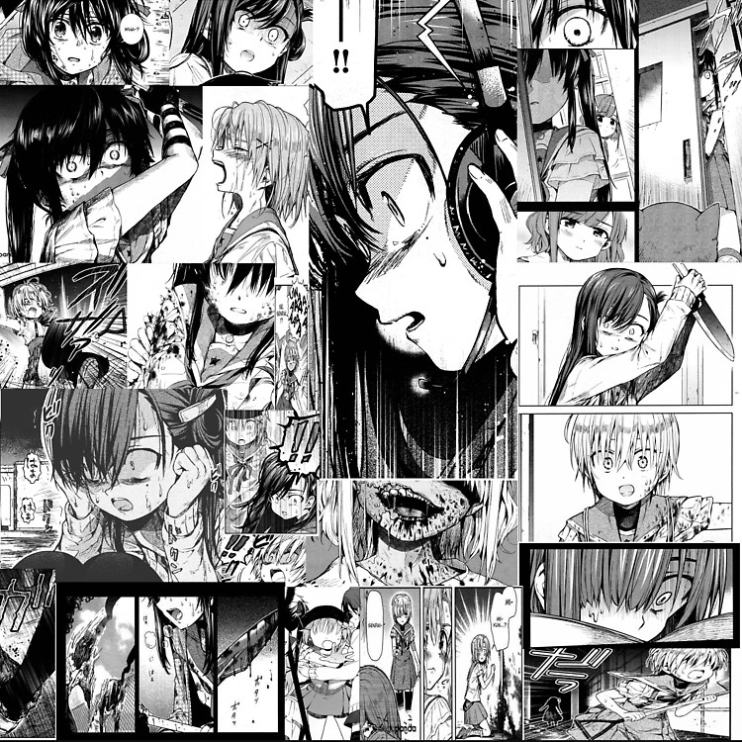
Audience
Any one that can read
Shonen（少年）for boys
Shoujo（少女） for girls
Seinen （青年）for adults

Slide 7
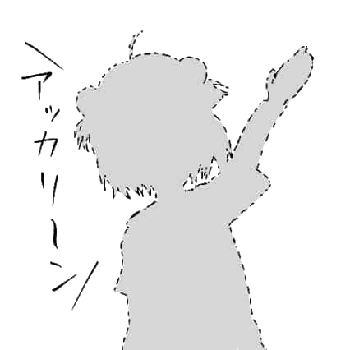
Language
Dialogue
Main element used to push the plot
Some times not in speech bubbles
Thoughts
Use to communicate emotion of character or for irony purposes
Sound effect
Better sense of mood
Narration
Assist development of plot

Slide 8
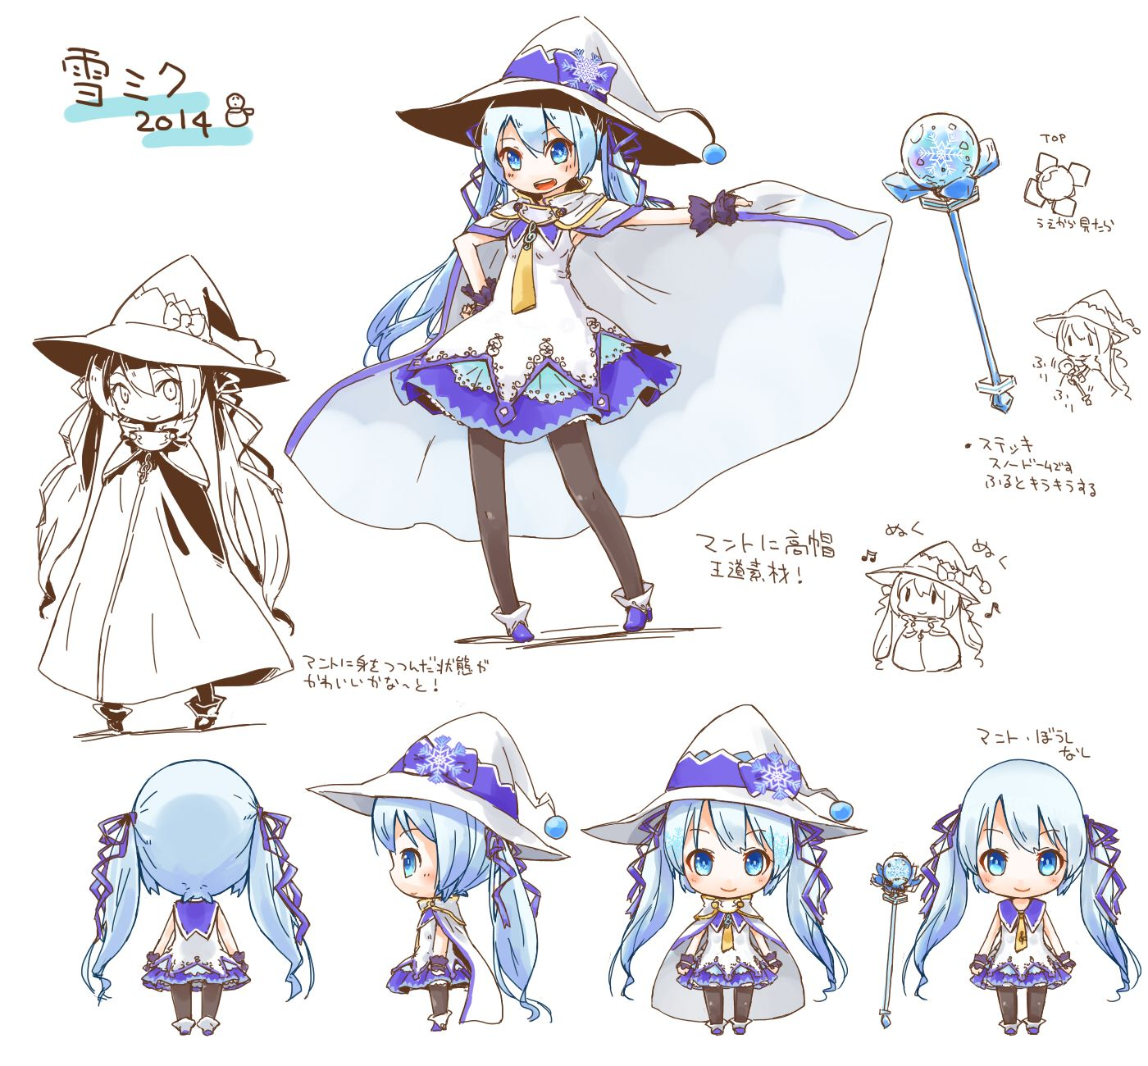
Character design
Appearance of the character
Personality
Twin-tail -> Tsundere
Long pink hair with closed eyes -> sly
Help differentiate between characters

Slide 9
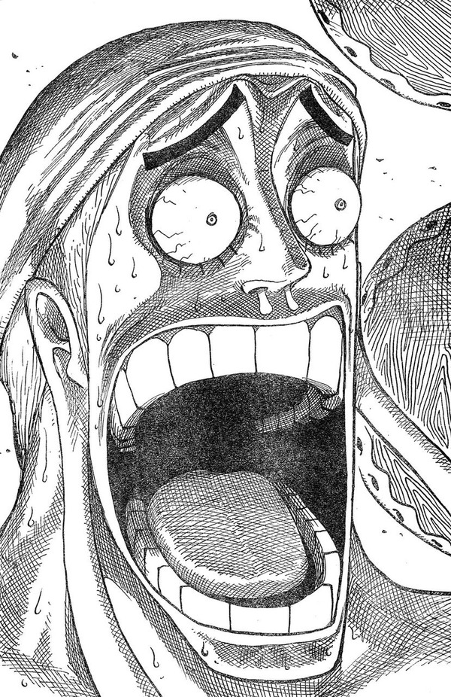
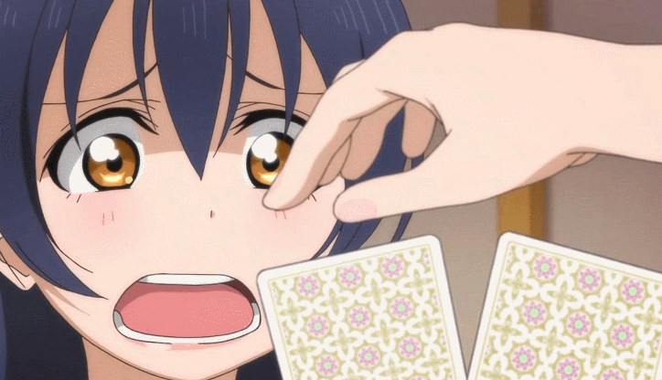
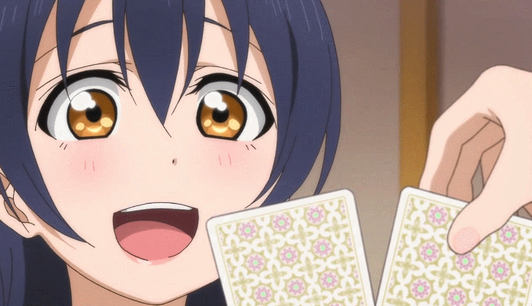
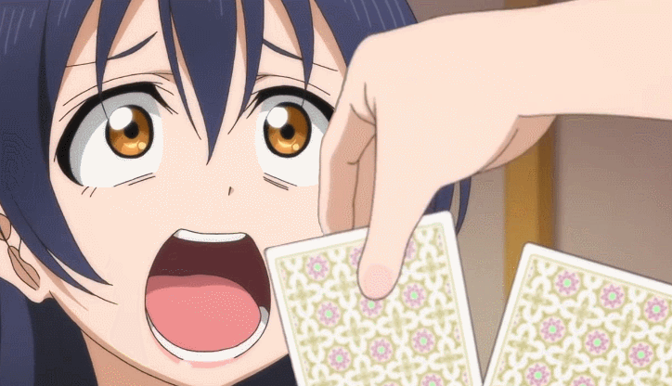
Kao-gei (颜芸)
Exaggerated facial expression
Extreme emotion
Comedy

